Slide 1


Noida Institute of Engineering and Technology, Greater Noida
Understanding Human Desirability
Unit: V
Subject Name: Design Thinking II
Course Details: B Tech 5th Sem

Slide 2
Faculty Profile
Experience | Details
Total Experience | 17 Yrs
Teaching Experience | 8th August 2006 to till now Subject Taught/Lab: Engineering Chemistry, Design Thinking-I, Environmental Science Subject Interest: Design Thinking-II
Industrial Work Experience | Nil
Research Work Experience | Oct 2008 to Jan 2011 in MMH College, Ghaziabad

Slide 3
Faculty Profile
Education Background | Details
Ph.D (Chemistry) | Ch. Charan Singh University, Meerut
M.Sc. (Organic Chemistry) | Ch. Charan Singh University, Meerut
B.Sc. (Chemistry) | Ch. Charan Singh University, Meerut

Slide 4
Faculty Profile: Coursera Achievements
IBM Cybersecurity Analyst certified on Jun 10,2022
Introduction to Cybersecurity Tools & Cyber Attacks Cybersecurity Roles, Processes & Operating System Security Cybersecurity Compliance Framework & System Administration Network Security & Database Vulnerabilities
Penetration Testing, Incident Response and Forensics Cyber Threat Intelligence
Cybersecurity Capstone: Breach Response Case Studies IBM Cybersecurity Analyst Assessment
IBM AI Engineering certified on May 23, 2022
Machine Learning with Python
Introduction to Deep Learning & Neural Networks with Keras Introduction to Computer Vision and Image Processing Deep Neural Networks with PyTorch
Building Deep Learning Models with TensorFlow AI Capstone Project with Deep Learning

Slide 5
Faculty Profile: Coursera Achievements
IBM Applied AI certified on May 19, 2022
Introduction to Artificial Intelligence (AI)
Getting Started with AI using IBM Watson
Building AI Powered Chatbots Without Programming
Python for Data Science, AI & Development
Python Project for AI & Application Development
Building AI Applications with Watson APIs
Programming with Google Go certified on May 12, 2022
Getting Started with Go
Functions, Methods, and Interfaces in Go
Concurrency in Go

Slide 6
Faculty Profile: Coursera Achievements
IBM Data Science certified on Apr 28, 2022
What is Data Science?
Tools for Data Science
Data Science Methodology
Python for Data Science, AI & Development
Python Project for Data Science
Databases and SQL for Data Science with
Python Data Analysis with Python
Data Visualization with Python
Machine Learning with Python
Applied Data Science Capstone
AI Product Management certified on Feb 10, 2022
Machine Learning Foundations for Product Managers Managing Machine Learning Projects
Human Factors in AI

Slide 7
Faculty Profile: Coursera Achievements
IBM Machine Learning certified on Sep 18, 2021
Exploratory Data Analysis for Machine Learning Supervised Machine Learning: Regression Supervised Machine Learning: Classification Unsupervised Machine Learning
Deep Learning and Reinforcement Learning Specialized Models: Time Series and Survival Analysis
AI Foundations for Everyone certified on Sep 3, 2021
Introduction to Artificial Intelligence (AI) Getting Started with AI using IBM Watson
Building AI Powered Chatbots Without Programming
Key Technologies for Business certified on Aug 28, 2021
Introduction to Cloud Computing
Introduction to Artificial Intelligence (AI)
What is Data Science?

Slide 8
Faculty Profile: Extracurricular Activities/Publications
Participated in National Conference on “Recent Advances in Electronics & Communication Engineering” (RACE-2014) March 28-29, 2014 on the topic “ A Review of Diversity Techniques in Wireless Communication”. https://www.its.edu.in/RACE2016/RACE2014/finalpdfpapers/RACE1059.pdf Participated in TECHTRIX-2014 on the project name “shop around”. Paper published in STM JOURNALS (Perspectives of cloud computing management: An Overview) http://stmjournals.com/index.php?journal=JoCTA&page=issue&op=current

Slide 9
Faculty Profile: Conferences/Seminars/FDP
Data Analysis Using Excel from E & ICT Academy, IIT Kanpur
Attended National Workshop in Data Analytics with Python conducted by Code Scholar and taught by TCS team.
Attended FDP on “Recent Advances and Challenges in Nanoscale Devices: Design, Materials, and Application Perspective” at NIT, Hamirpur certified by AICTE Training and Learning (ATAL) Academy.
Attended One-week short-term training program on Data Science and its applications sponsored by AICTE in NIET, Greater Noida.
FDP on Machine Learning from ITS Engineering College, Greater Noida.
FDP on Data Science from EXCELR.
Participated in one week Faculty Development Programme on “Big Data Analytics” at Gautam Buddha University.
Participated in “Career Oriented Seminar” at Gautam Buddha University.
Participated in National Conference on “Recent Advances in Communication, Electronics &Electrical Engineering” (RACE-2015) March 27-28, 2015.
Participated in the Pre-Conference Tutorial Co- located with IEEE International Conference on Computer & Computational Sciences (ICCCS-2015).

Slide 10
Faculty Profile: Workshop
National Webinar on “Covid-19 & Related Technology Developed by Engineering Institutes” conducted by Department of Applied Sciences and Humanities, Rajkiya Engineering College, Mainpuri Attended 3-days National workshop on “NAAC Assessment and Accrediation: A Step by Step Process at ChadalawadaRamanamma Engineering College, Tirupathi-517506, Andhra Pradesh. Attended Workshop on startup opportunity for youth in 2021, to make India Atmanirbhar held at Galgotias Engineering College, Greater Noida. Attended workshop on National Innovation and Startup policy: Role of technical Institution in Technological Innovation & IPR creation in Nation Building held at Galgotias Engineering College, Greater Noida. Attended e-lecture on Pedagogical view of developing 21st-century problem solving and programming skills in budding IT professionals organized by Dr. A.P.J Abdul Kalam Technical University, Lucknow, U.P. Two days’ workshop on “Computational Nanotechnology and Nano electronics” organised by Dept. of Electrical Engineering, SOE, GBU, Gr. Noida. National Workshop on Optimization Techniques for Solving Multidisciplinary Research Problems in Engineering Sciences(OTSMRPES-2014). One day workshop on Linux from DUCAT. One day workshop on PHP from DUCAT. Workshop on MATLAB from I.T.S Engineering College.

Slide 11
Faculty Profile: Trainings/ Internship
Mapping Skills, Greater Noida
PythonBootcamp under the guidance of Mapping Skills.
Data Science and Machine Learning in Python
Vocational/Practical Training : MTA (Microsoft Training Associate) certified .NET:
Practical (vocational) training under the guidance of ATS Infotech
.NET Fundamentals
Web Development Fundamentals
Vocational/Practical Training : JAVA from DUCAT, Greater Noida:-
Practical (vocational) training under the guidance of DUCAT, Greater Noida.
Core JAVA
Advanced JAVA
Internship :C & C++, DUCAT, Greater Noida:
Basics of C & C++.

Slide 12
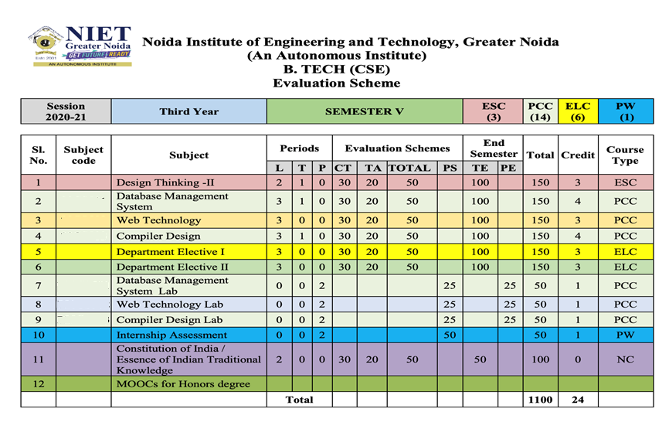
Evaluation Scheme

Slide 13
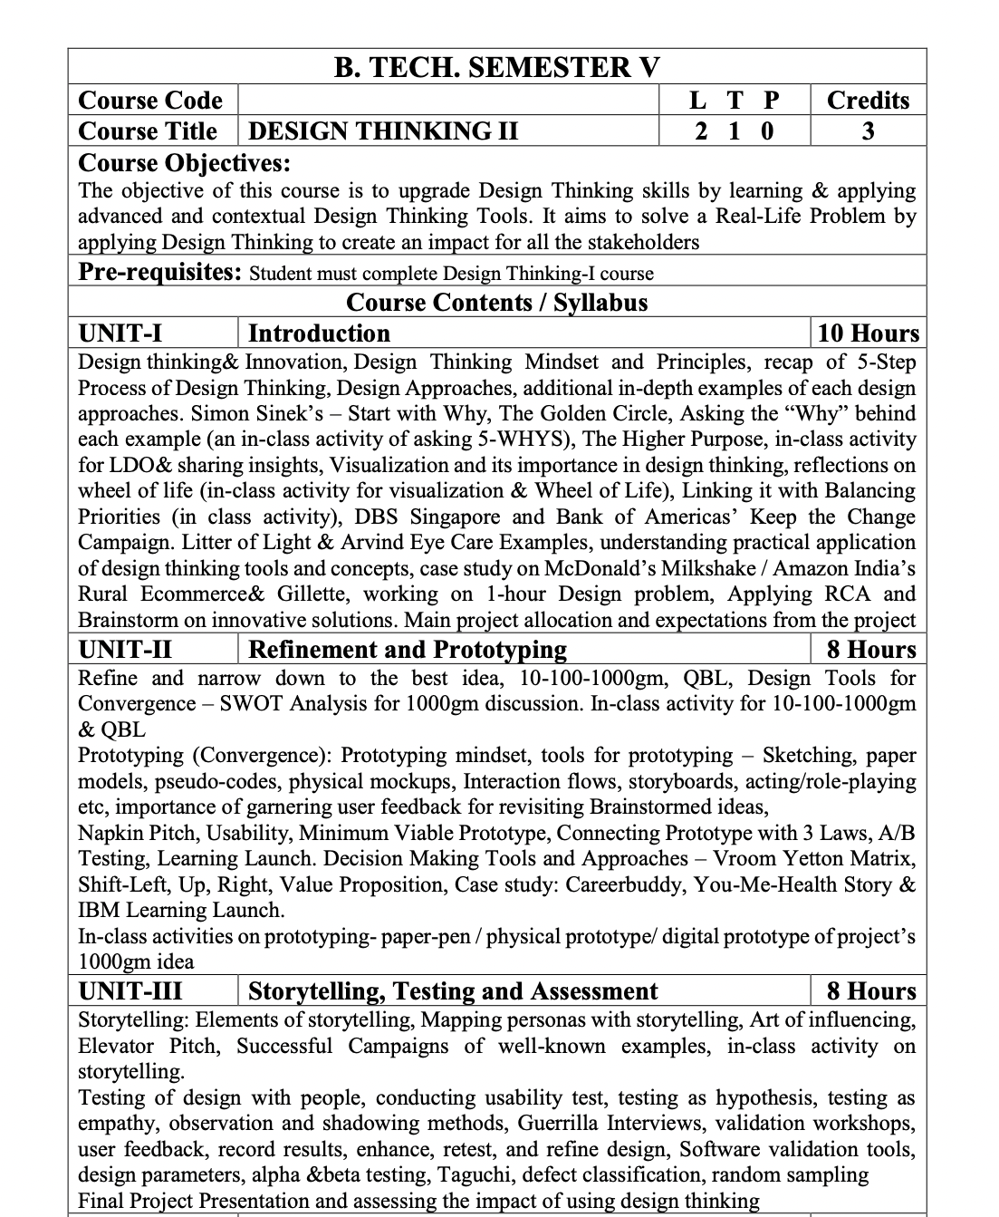
Syllabus

Slide 14
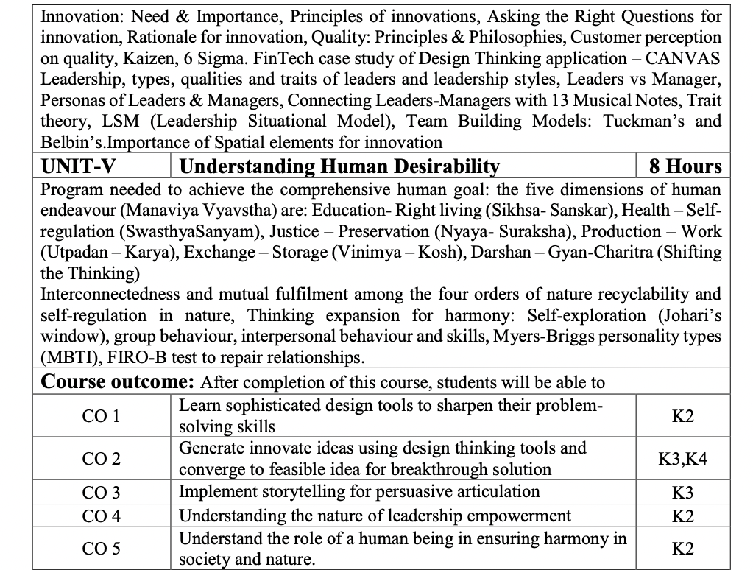
Syllabus

Slide 15

Content
Achieve the comprehensive human goal: the five dimensions of human endeavour(Manaviya Vyavstha) are:
Education- Right living (Sikhsa- Sanskar),
Health – Self-regulation (SwasthyaSanyam),
Justice – Preservation (Nyaya- Suraksha),
Production – Work ( Utpadan – Karya),
Exchange – Storage (Vinimya – Kosh),
Darshan-Gyan-Charitra (Shifting the Thinking)
Interconnectedness and mutual fulfilment among the four orders of nature recyclability and self-regulation in nature
Thinking expansion for harmony:
Self-exploration (Johari’s window),
group behaviour,
interpersonal behaviour and skills,
Myers-Briggs personality types (MBTI),
FIRO-B test to repair relationships.

Slide 16
Course Objective
The objective of this course is to upgrade Design Thinking skills by learning & applying advanced and contextual Design Thinking Tools.
It aims to solve a Real-Life Problem by applying Design Thinking to create an impact for all the stakeholders

Slide 17
Course Outcome
After completion of this course, students will be able to-
CO1: Learn sophisticated design tools to sharpen their problem- solving skills.
CO2: Generate innovate ideas using design thinking tools and converge to feasible idea for breakthrough solution.
CO3: Implement storytelling for persuasive articulation
CO4: Understanding the nature of leadership empowerment
CO5: Understand the role of a human being in ensuring harmony in society and nature.

Slide 18
Program Outcomes (POs)
Engineering Graduates will be able to:
PO1 : Engineering Knowledge
PO2 : Problem Analysis
PO3 : Design/Development of solutions
PO4 : Conduct Investigations of complex problems
PO5 : Modern tool usage
PO6 : The engineer and society

Slide 19
Program Outcomes (POs) cont…
Engineering Graduates will be able to:
PO7 : Environment and sustainability
PO8 : Ethics
PO9 : Individual and teamwork
PO10 : Communication
PO11 : Project management and finance
PO12 : Life-long learning

Slide 20

COs - POs Mapping
CO.K | PO1 | PO2 | PO3 | PO4 | PO5 | PO6 | PO7 | PO8 | PO9 | PO10 | PO11 | PO12
CO1 | 2 | 2 | 2 | 3 | 3 | 2 | 2 | 2 | 3 | 2 | 3 | 3
CO2 | 3 | 2 | 3 | 2 | 3 | 2 | 2 | 3 | 2 | 2 | 2 | 3
CO3 | 3 | 2 | 3 | 2 | 3 | 2 | 2 | 3 | 2 | 2 | 2 | 3
CO4 | 3 | 2 | 3 | 2 | 3 | 2 | 2 | 3 | 2 | 2 | 2 | 3
CO5 | 3 | 2 | 3 | 3 | 3 | 2 | 2 | 3 | 3 | 2 | 3 | 3
AVG | 2.8 | 2.0 | 2.8 | 2.4 | 3.0 | 2.0 | 2.0 | 2.8 | 2.4 | 2.0 | 2.4 | 3.0

Slide 21
Program Outcomes (POs)
CO.K | PSO1 | PSO2 | PSO3 | PSO4
CO1 | 3 | - | - | -
CO2 | 3 | 3 | - | -
CO3 | 3 | 3 | - | -
CO4 | 3 | 3 | - | -
CO5 | 3 | 3 | - | -

Slide 22
Program Educational Objectives (PEOs)
Program Educational Objectives (PEOs) | PEOs Description
PEOs | To have an excellent scientific and engineering breadth so as to comprehend, analyze, design and provide sustainable solutions for real-life problems using state-of-the-art technologies.
PEOs | To have a successful career in industries, to pursue higher studies or to support entrepreneurial endeavors and to face the global challenges.
PEOs | To have an effective communication skills, professional attitude, ethical values and a desire to learn specific knowledge in emerging trends, technologies for research, innovation and product development and contribution to society.
PEOs | To have life-long learning for up-skilling and re-skilling for successful professional career as engineer, scientist, entrepreneur and bureaucrat for betterment of society.

Slide 23
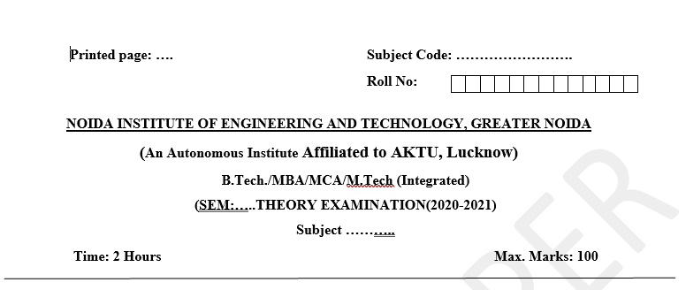
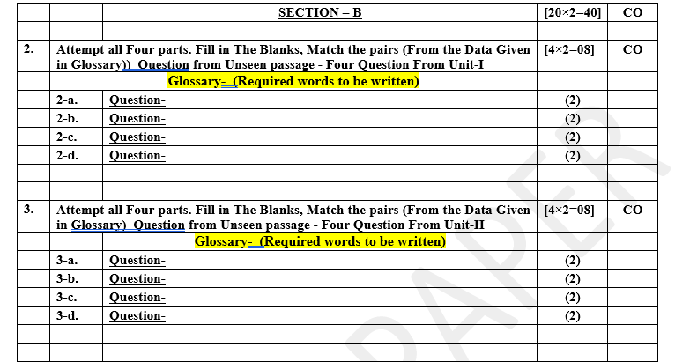
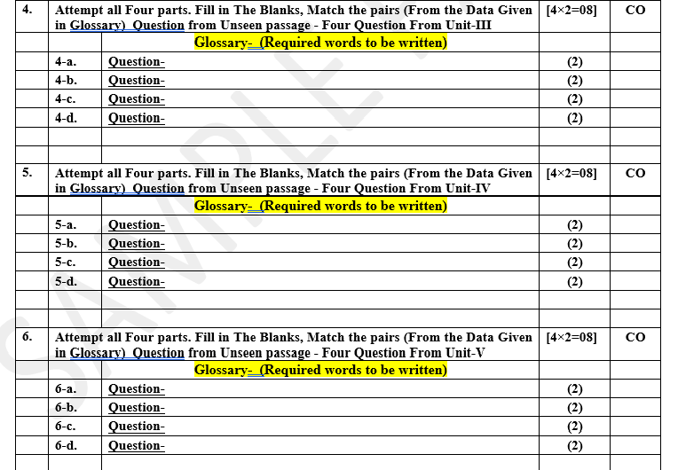
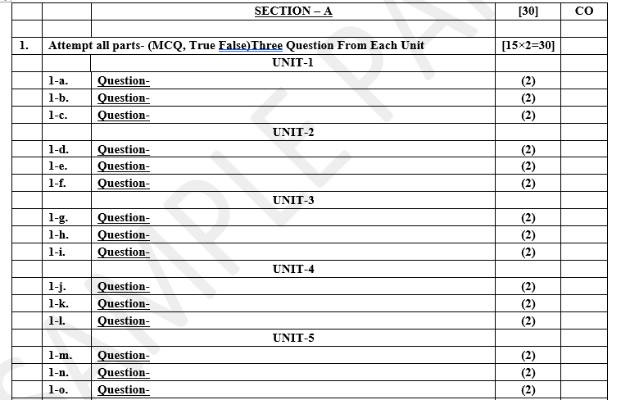
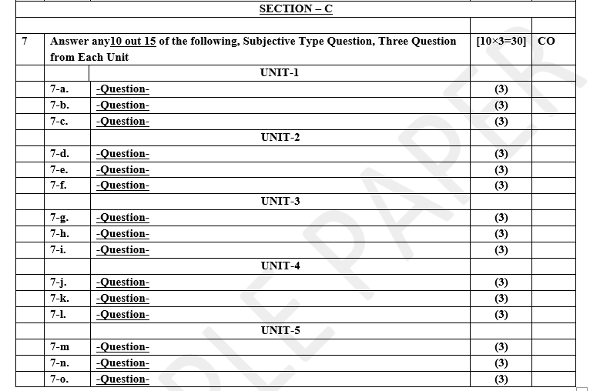
Pattern of Online External Exam Question Paper (100 marks)

Slide 24
Prerequisite and Recap
Pre-requisites: Understanding of Universal Human Goal, Human as a coexistence of Self & body and their requirements, 9 feelings of relationship, Maslow’s hierarchy of needs
Recap:
Human is combination of Self and body
Need of self can not be fulfilled by physical facility
Needs of body can not be fulfilled by feelings
Trust is foundation value
Love is complete value

Slide 25
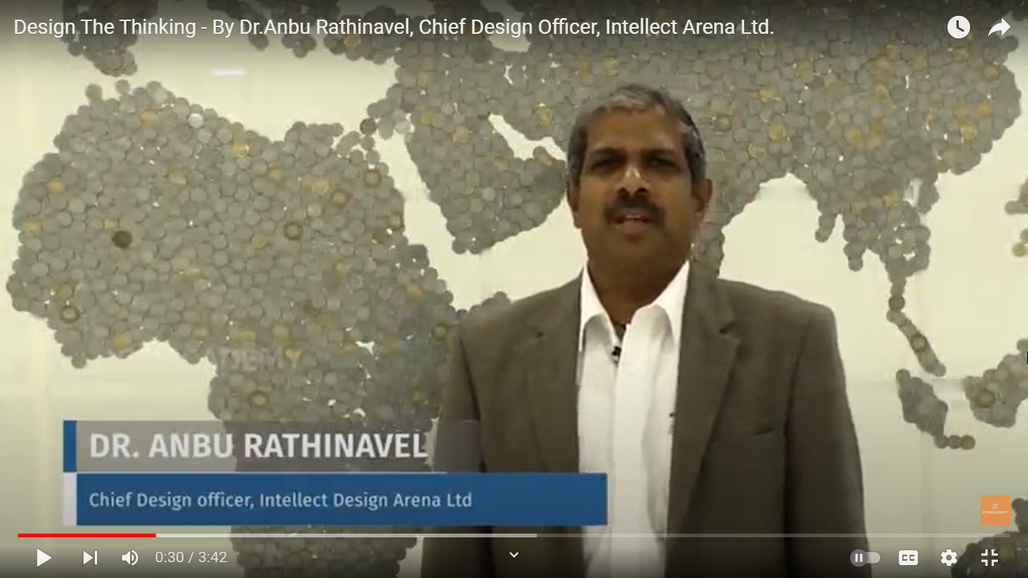
Subject Introduction
https://youtu.be/Eu80OPztGGw

Slide 26
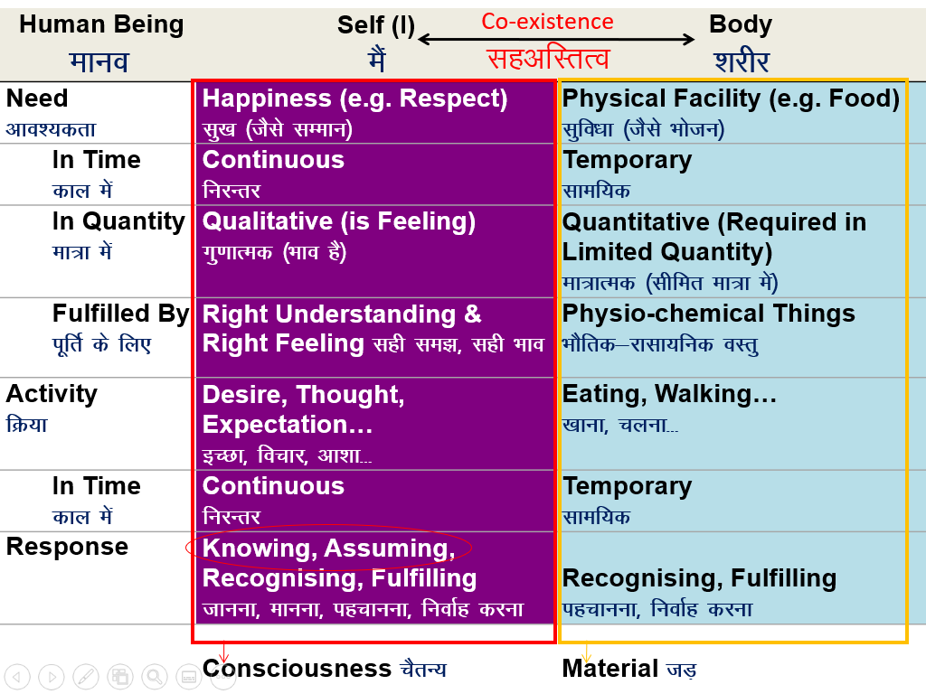
Recap: Human as a co-existence of ‘I’ (self) and body

Slide 27
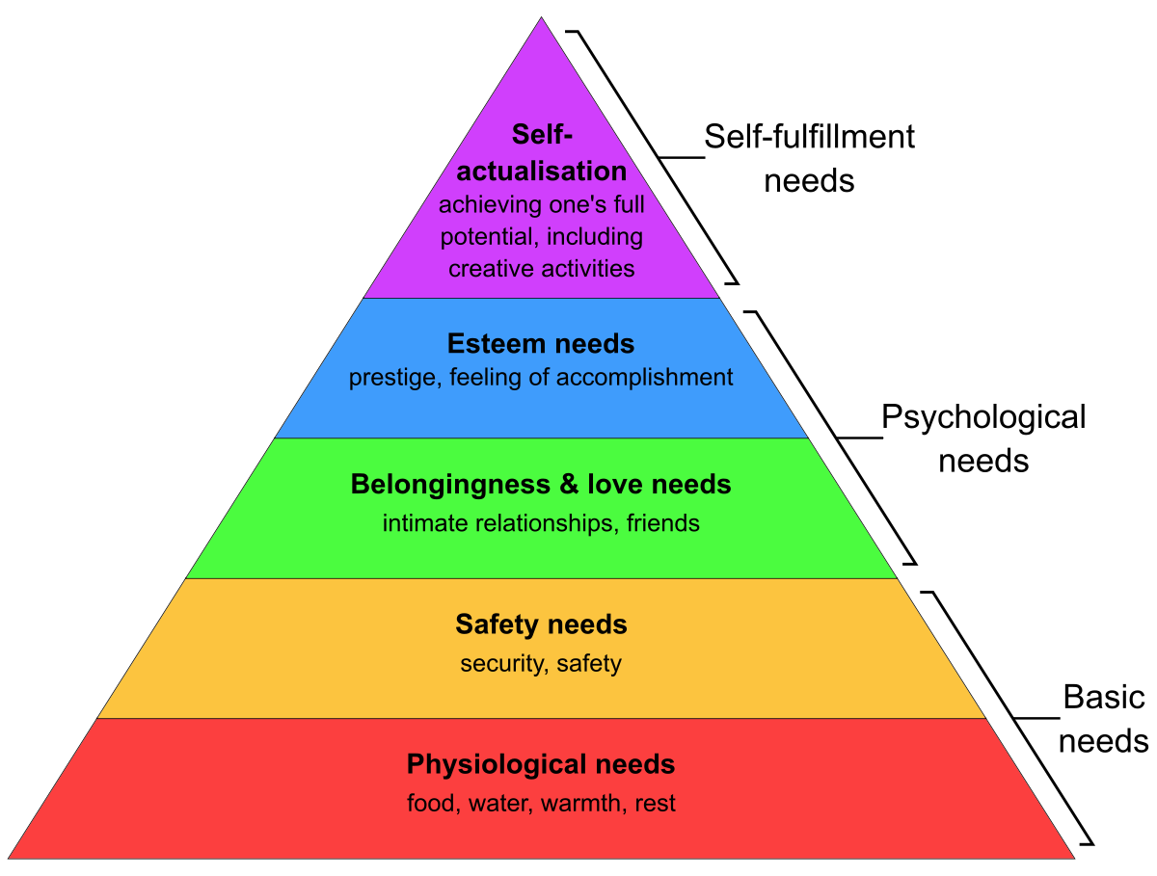
Recap: Maslow’s Hierarchy of needs (CO5)

Slide 28
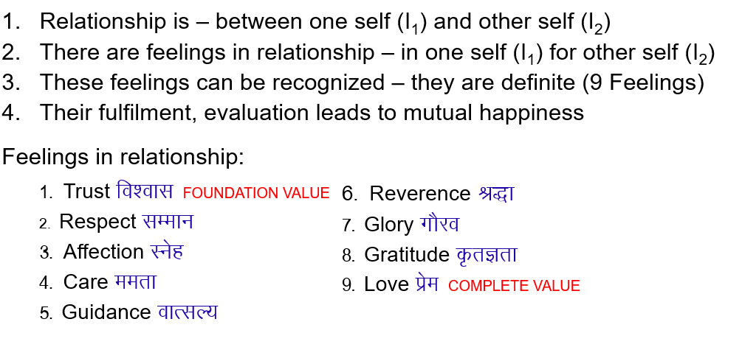
Recap: Feelings in relationship (CO5)

Slide 29
Achieve the comprehensive human goal

Slide 30
Achieve the comprehensive human goal (CO5)
Objective:
To Understand Comprehensive human goals as right understanding, prosperity, fearlessness and co-existence.

Slide 31
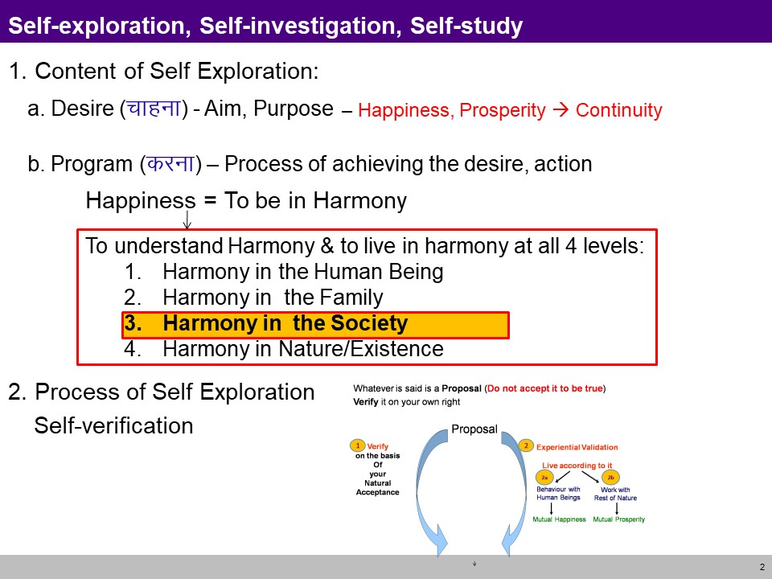
Achieve the comprehensive human goal (CO5)

Slide 32
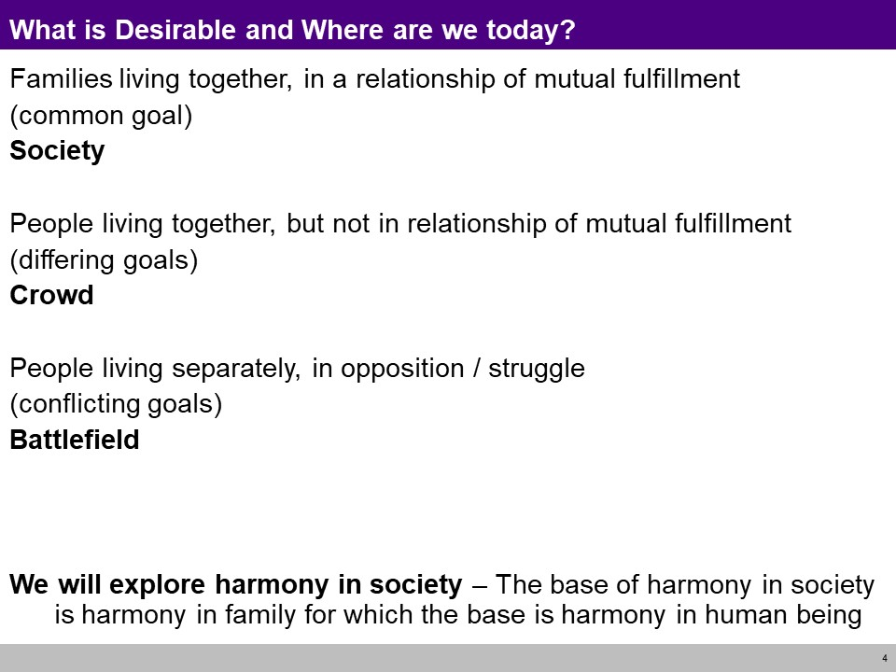
Achieve the comprehensive human goal (CO5)

Slide 33
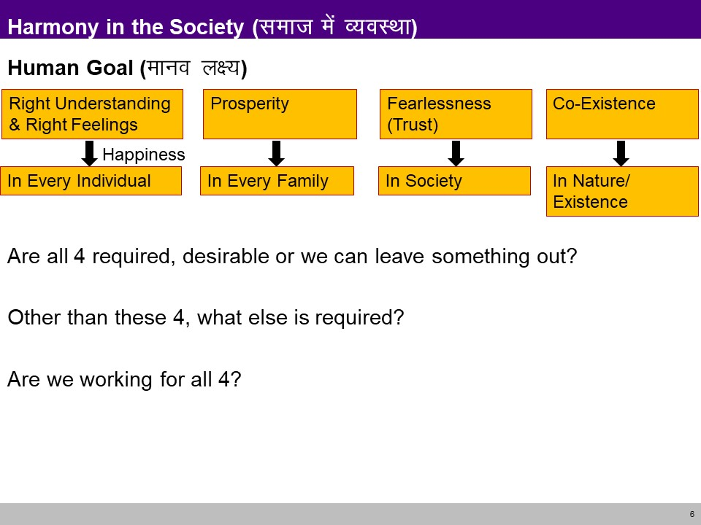
Achieve the comprehensive human goal (CO5)

Slide 34
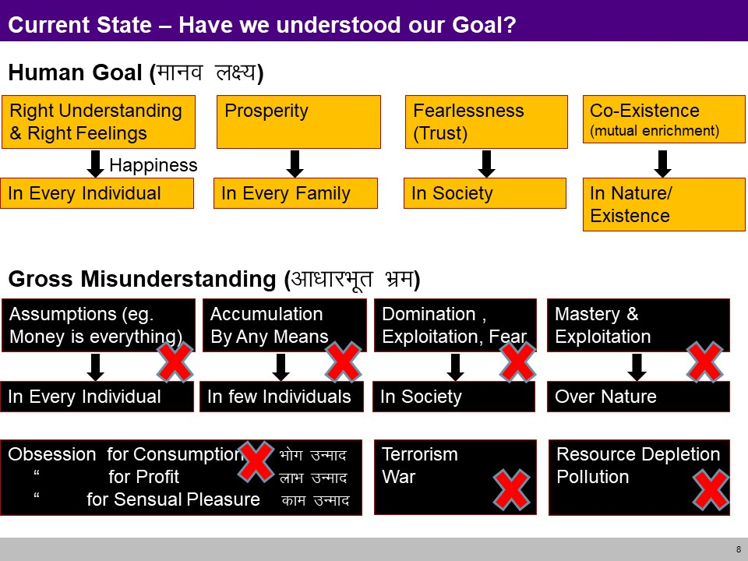
Achieve the comprehensive human goal (CO5)

Slide 35
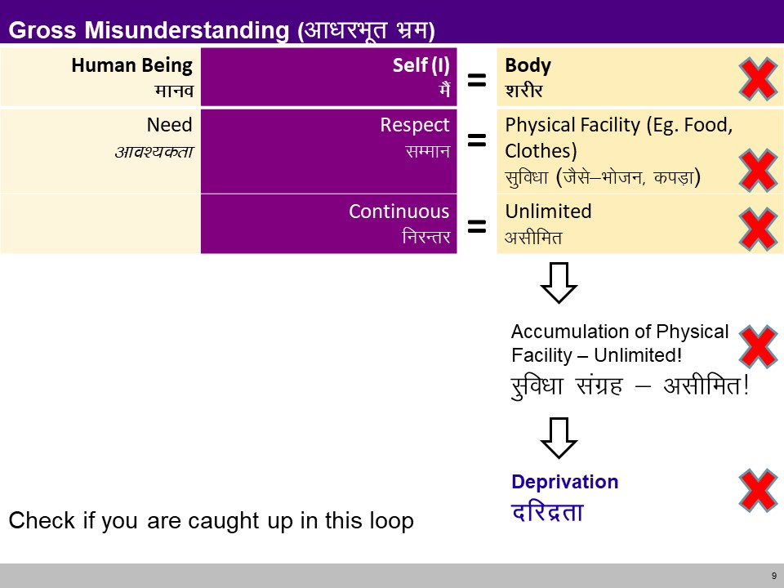
Achieve the comprehensive human goal (CO5)

Slide 36
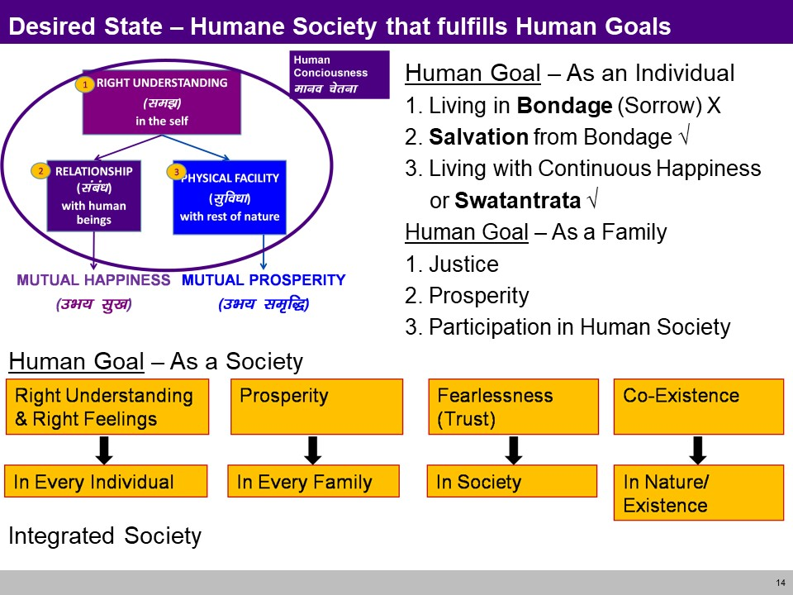
Achieve the comprehensive human goal (CO5)

Slide 37
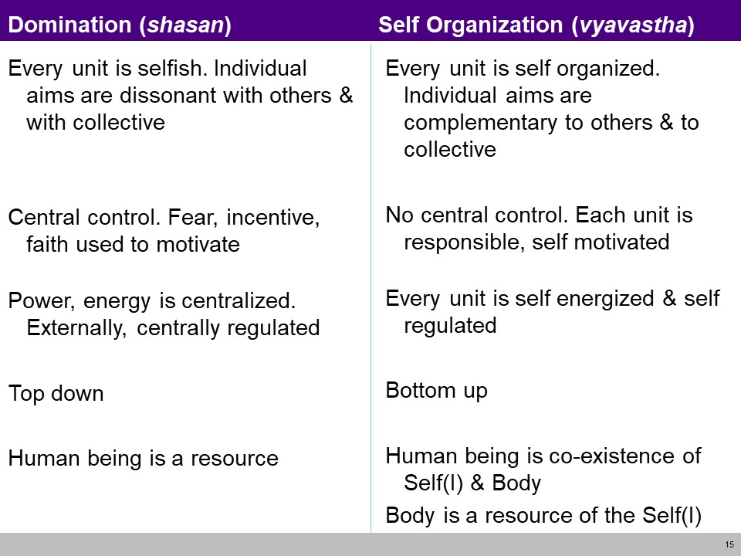
Achieve the comprehensive human goal (CO5)

Slide 38
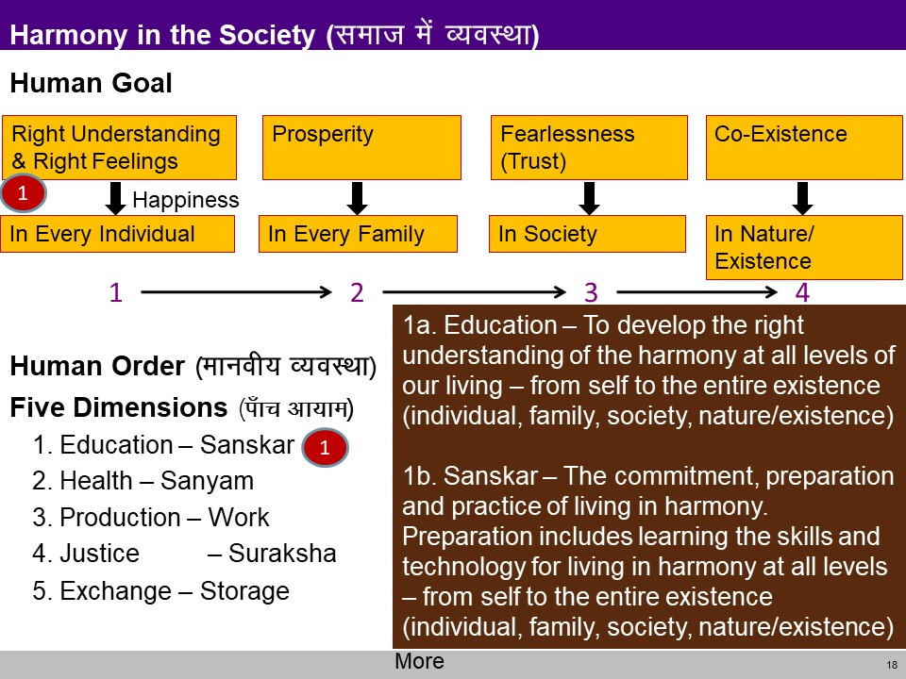
Achieve the comprehensive human goal (CO5)

Slide 39
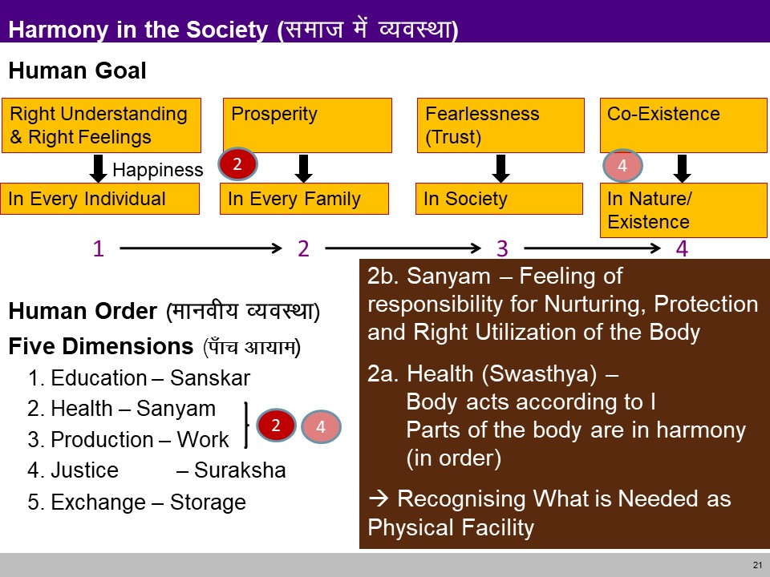
Achieve the comprehensive human goal (CO5)

Slide 40
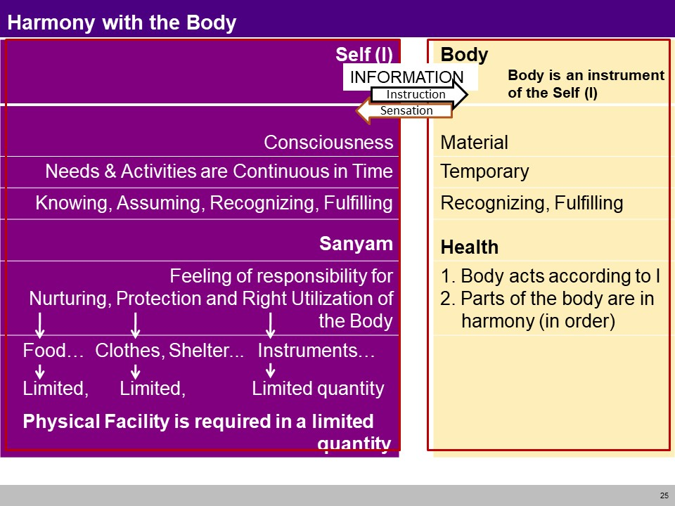
Achieve the comprehensive human goal (CO5)

Slide 41
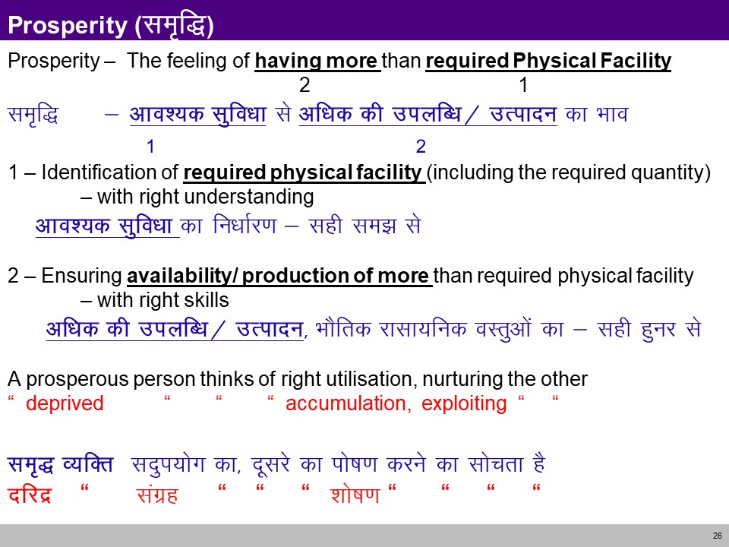
Achieve the comprehensive human goal (CO5)

Slide 42
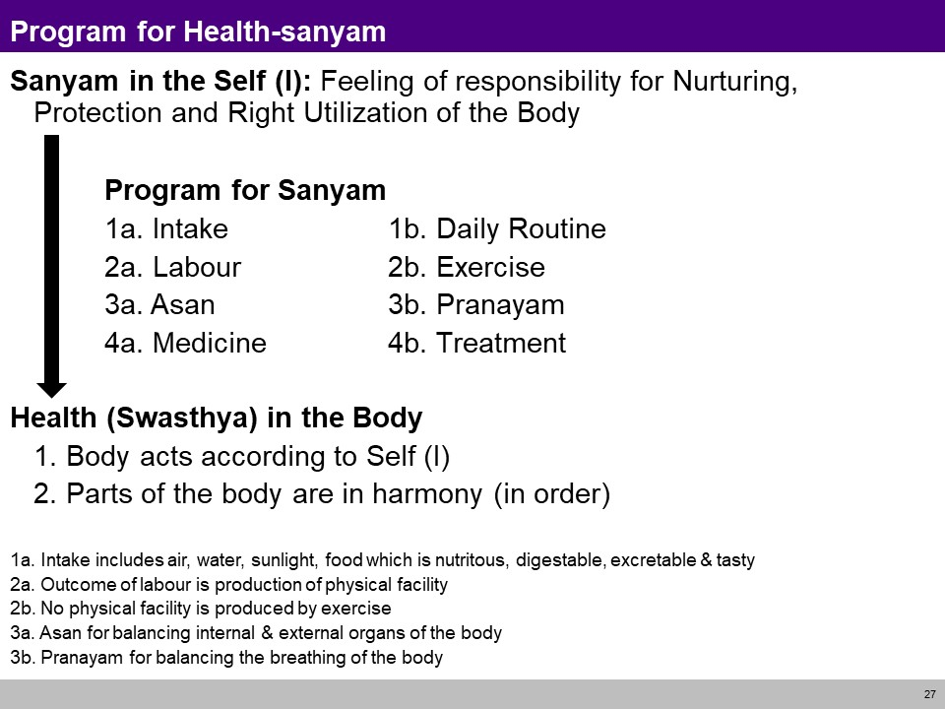
Achieve the comprehensive human goal (CO5)

Slide 43
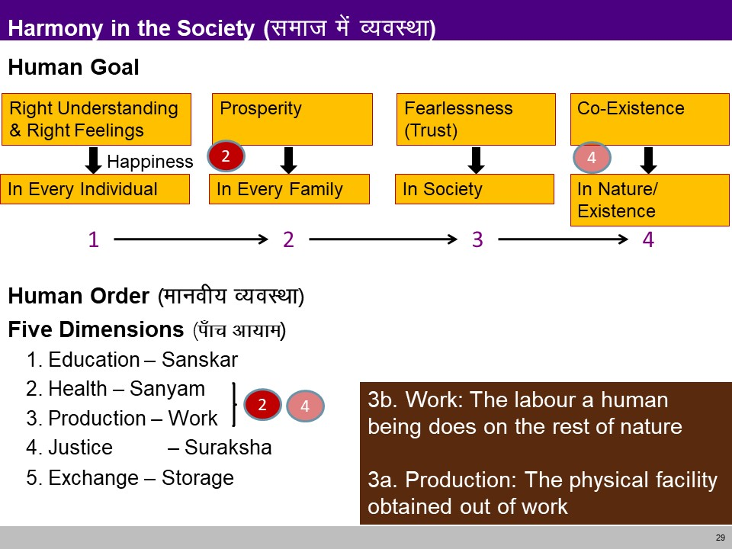
Achieve the comprehensive human goal (CO5)

Slide 44
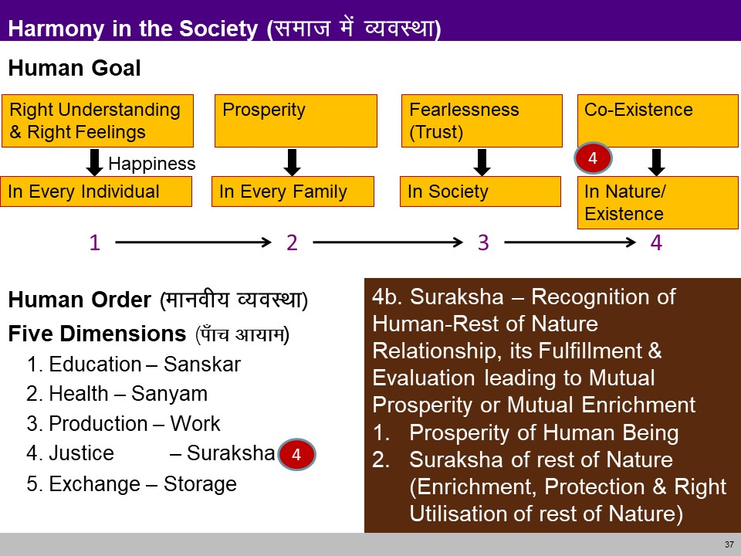
Achieve the comprehensive human goal (CO5)

Slide 45
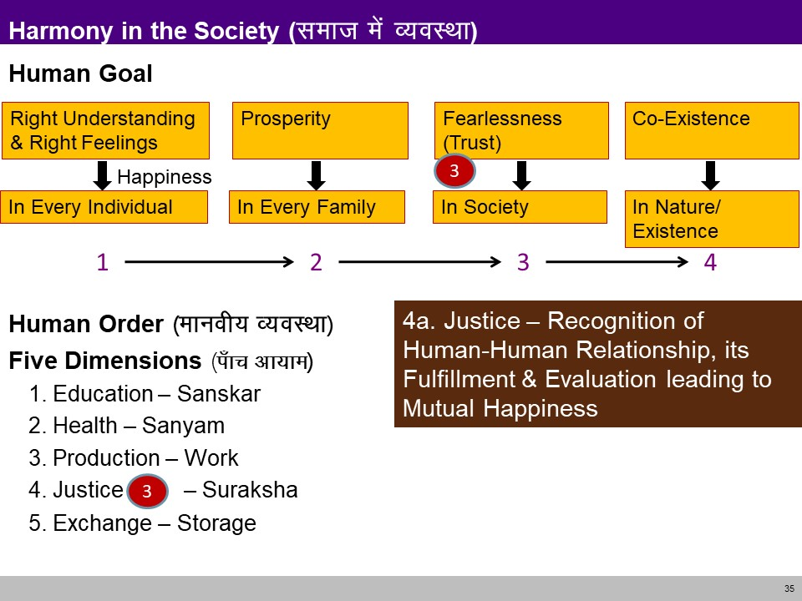
Achieve the comprehensive human goal (CO5)

Slide 46
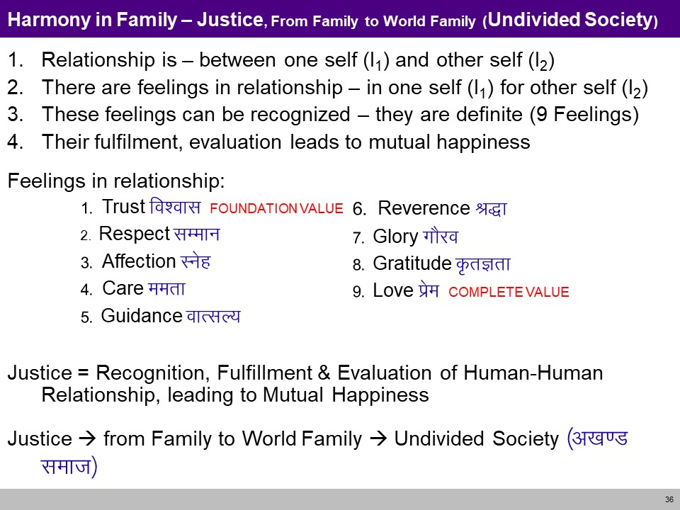
Achieve the comprehensive human goal (CO5)

Slide 47
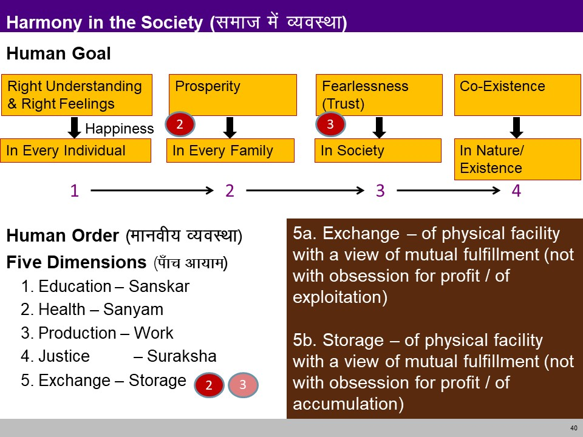
Achieve the comprehensive human goal (CO5)

Slide 48
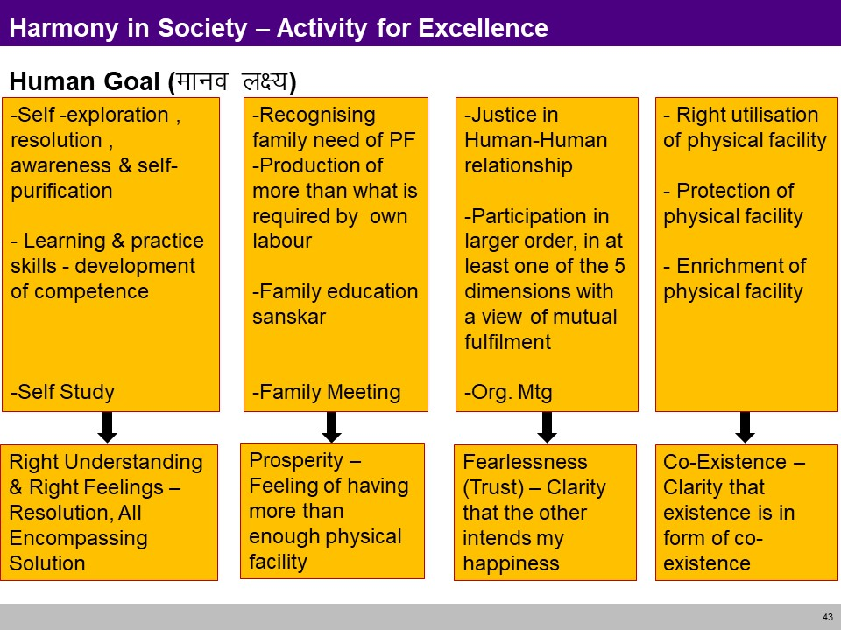
Achieve the comprehensive human goal (CO5)

Slide 49
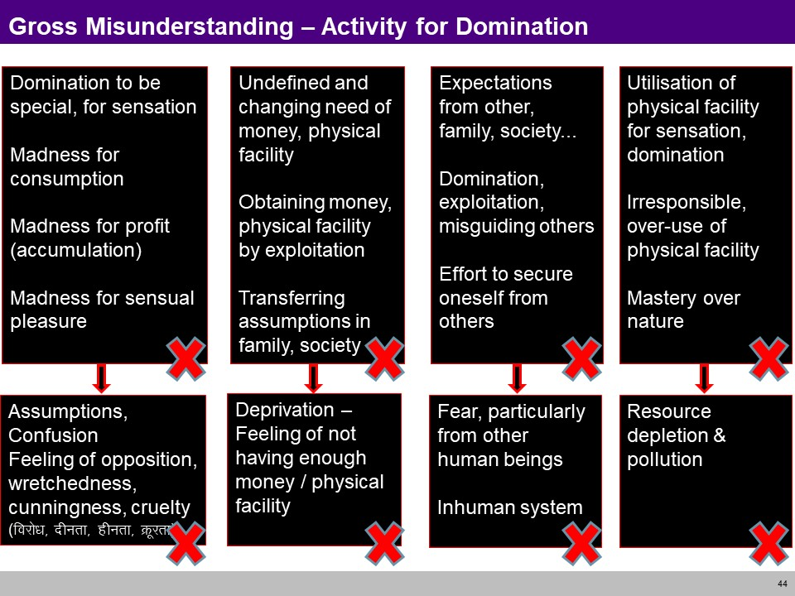
Achieve the comprehensive human goal (CO5)

Slide 50
Darshan Gyan Charitra (Shifting the Thinking)

Slide 51
Darshan, Gyan, Charitya(CO5)
Objective:
To Understand Samyak-Darshan refers to Right View or Right Belief whereas Samyak-Gyan refers to Right Knowledge

Slide 52
Darshan, Gyan, Charitya(CO5)
Theory of Knowledge (Gyan)
Knowledge is eight types Matijnana , Shrutajnana , Avadhijnana , Manahparyayajnana , Keval jnana , and three ignorance, Kumati , Kushruta , Kuavadhi
Darshan is four types Chaksu , Achaksu, Avadhi , Kevala
Right conduct - Samyak charitra
This means living your life according to Jain ethical rules, to avoid doing harm to living things and freeing yourself from attachment and other impure attitudes and thoughts.

Slide 53
Gyan (CO5)
The Jain, scholars divide cognition or knowledge into two divisions viz. -
Valid knowledge
Fallacious knowledge
The valid knowledge is of five types viz. -
Sensory knowledge (Mati Jnana)
Scriptural knowledge (Shruta Jnana)
Clairvoyance (Avadhi Jnana)
Telepathy (manahparyaya jnana)
Omniscience (Kevala Jnana)
The fallacious knowledge is of three types viz. -
Kumati,
Kusruta
Vibhang

Slide 54
Gyan (CO5)
The valid knowledge
Sensory knowledge (Mati Jnana)
Scriptural knowledge (Shruta Jnana)
Clairvoyance (Avadhi Jnana)
Telepathy (manahparyaya jnana)
Omniscience (Kevala Jnana)

Slide 55
Gyan (CO5)
The valid knowledge
Mati jnana or sensuous knowledge is ordinary cognition, obtained by normal functioning of sense perception. It is based on sensuous perception. According to the ancient texts, mati jnana is described as synonymous with intelligence and it includes remembrance, recognition and inductive as well as deductive reasoning. "Mati jnana is sometimes further distinguished into three kinds viz. upalabdhi or perception, bhavana or memory, and upyoga or understanding".
Shruta jnana or authoritative knowledge is knowledge derived through symbols, signs or words. All verbal knowledge is shruta jnana. It includes all canonical, scriptural or both knowledge. "Shruta jnanais of four kinds, namely,
labdhi or association,
bhavana or attention,
upayoga or understanding, and
naya or aspects of the meaning of things".
Shruta jnana is invariably preceded by mati jnana. As we saw, mati jnana cognizes only what is present, the shruta jnana comprehends, all the three time dimensions (past, present and future) relating to the object. "While mati jnana gives us knowledge by acquaintance, this (shruta) gives us knowledge by description.”

Slide 56
Gyan (CO5)
The valid knowledge
Avadhi jnana or clairvoyant is a sort of clairvoyant knowledge or direct visual intuition which enables a person to know things or objects even at a distance of time or space, without their coming into contact with sense organs.
Manah paryaya or telephathic knowledge is a direct knowledge of the thoughts of the minds of others. It is without the help of any medium or agency. Just like avadhi jnana, manah paryaya jnana is an extra sensory perception. Manah paryaya can not be attained by ordinary persons. Only a soul in its higher progression stage or at its higher 'guna-sthana' may acquire this type of knowledge.
Keval jnana or perfect knowledge "comprehends all substances and their modifications." It is the pure, absolute, complete, whole and total knowledge unlimited by space, time or object. It is the very omniscience. Omniscience according to Jainism is possible, it is the highest type of perception which falls in the category of extra-sensory perception. It is the perception of the cognising faculty of self. Keval jnana is possible only when all the jnana obscuring karmas have been totally annihilated. It is independent of senses, can be only felt and cannot be described. This supreme and unlimited knowledge is possessed only by purified souls free from bondage like Arihants and Siddhas.

Slide 57
Gyan (CO5)
The fallacious knowledge
Kumati: Wrong sensory knowledge
Kusruta: Wrong scriptural knowledge
Vibhang: wrong divining

Slide 58
Darshan (CO5)
Darshan is of four kinds
Chaksu visual apprehension
Achaksu non visual apprehension with the aid of mind, ear, nose, tongue and skin.
Avadhi apprehension directly by the soul without the aid of senses and mind.
Clairvoyance Kevala perfect apprehension by the soul.

Slide 59
Charitra (CO5)
Right faith and right knowledge are prerequisite to right conduct.
Right conduct is essential for self realization or liberation, or for success in life.
Right conduct requires observance of austerities, e. g. simple living and high thinking
Checking of external activities of body, mind and speech, i.e. checking distraction of attention
Meditation and contemplation on the true nature of the soul, or the goal
Right conduct is of two categories:
1 . Sakal Samyagcharitra rules of conduct are followed with vigor, Mahavratas . This is for ascetics
2 . Vikal Samyagcharitra rules are followed as much as possible, Anuvratas . This is for householders
Besides following the rules the person should absent from vices.

Slide 60
Interconnectedness and mutual fulfilment among the four orders of nature recyclability and self-regulation in nature

Slide 61
Interconnectedness and mutual fulfilment among the four orders of nature (CO5)
Objective:
To Understand interconnectedness and mutual fulfilment in all the orders of nature except human order

Slide 62
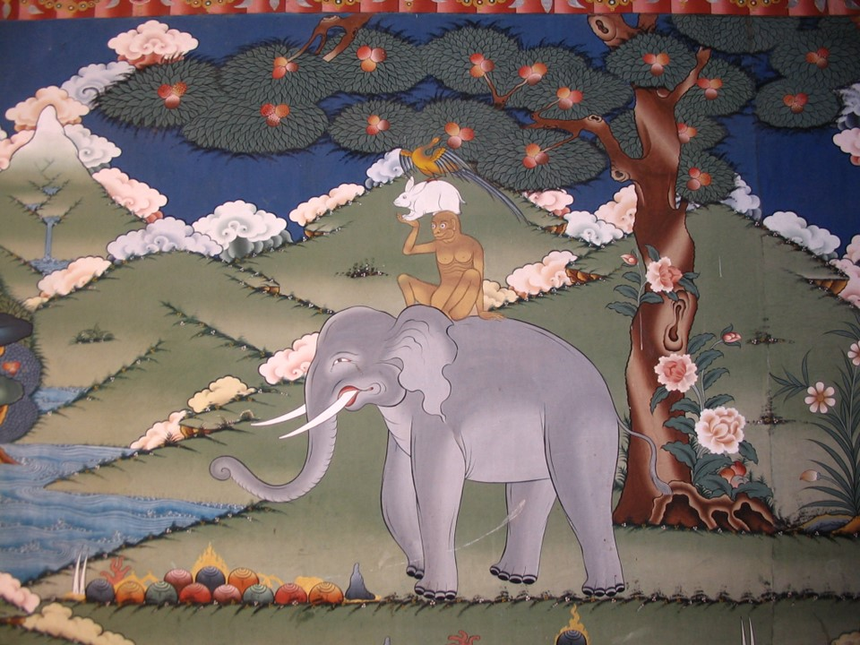
Interconnectedness and mutual fulfilment among the four orders of nature (CO5)

Slide 63
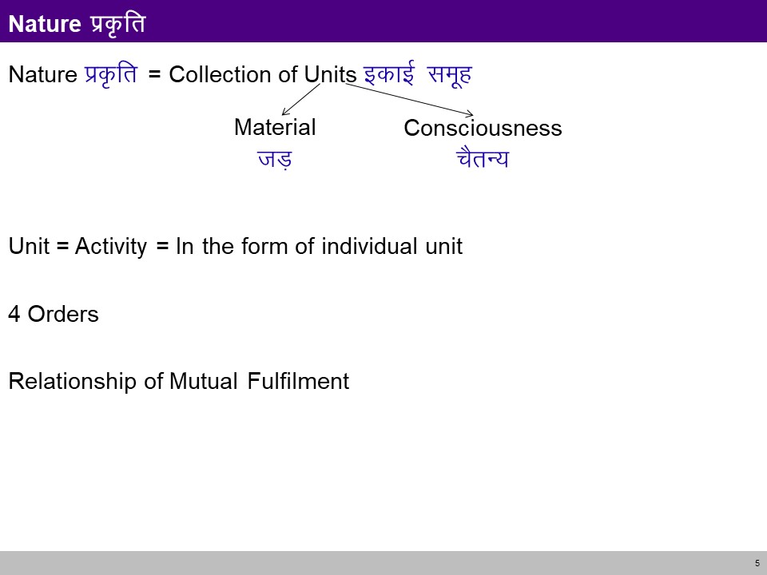
Interconnectedness and mutual fulfilment among the four orders of nature (CO5)

Slide 64
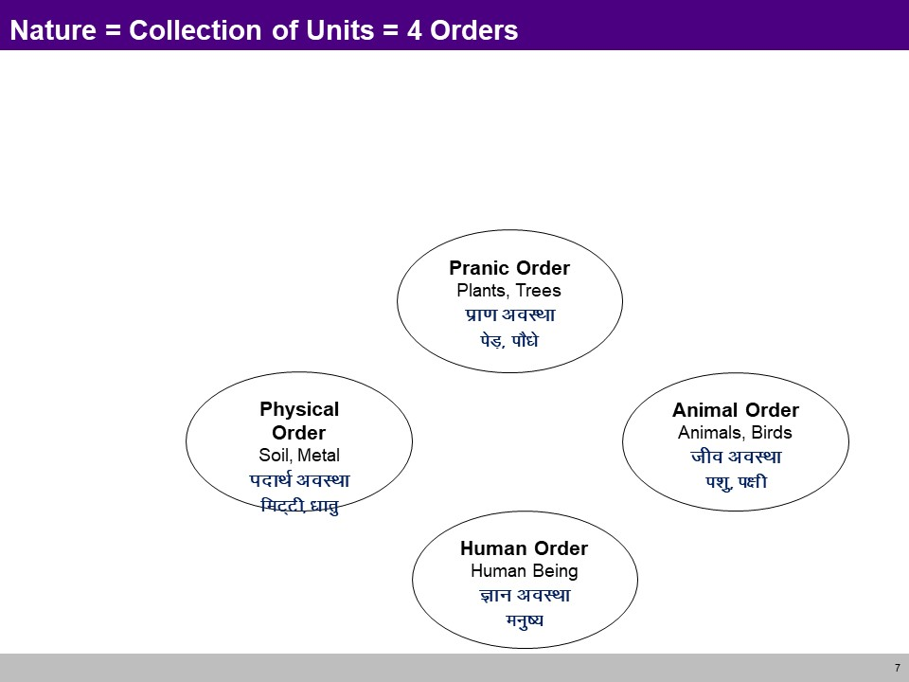
Interconnectedness and mutual fulfilment among the four orders of nature (CO5)

Slide 65
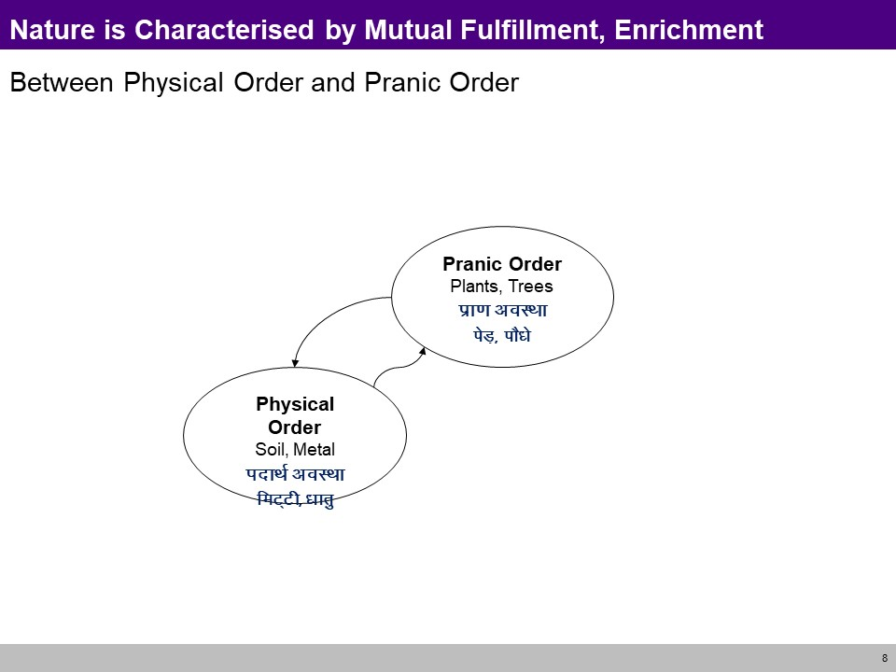
Interconnectedness and mutual fulfilment among the four orders of nature (CO5)

Slide 66
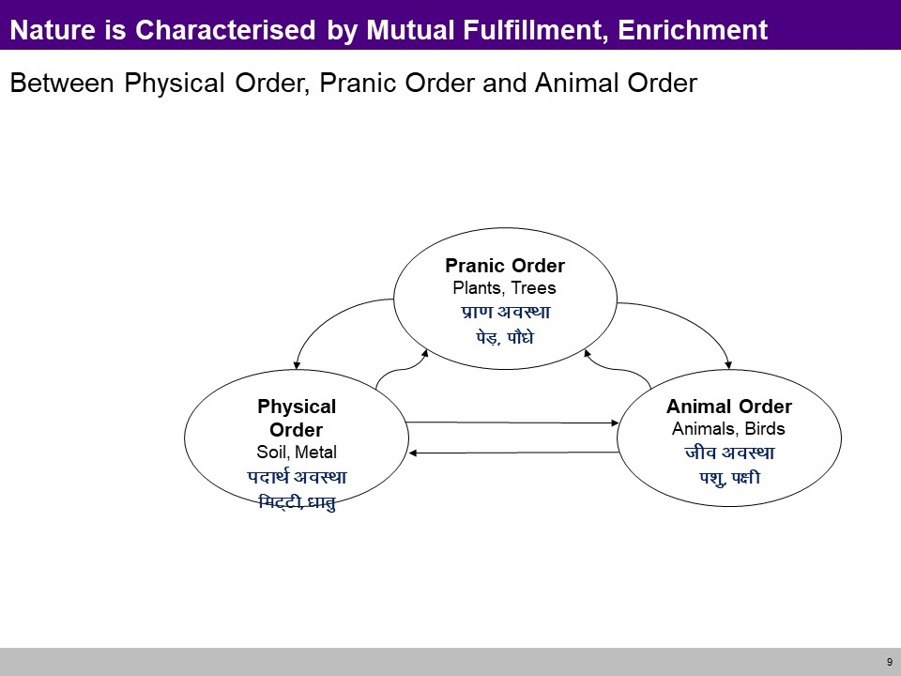
Interconnectedness and mutual fulfilment among the four orders of nature (CO5)

Slide 67
Interconnectedness and mutual fulfilment among the four orders of nature (CO5)

Slide 68
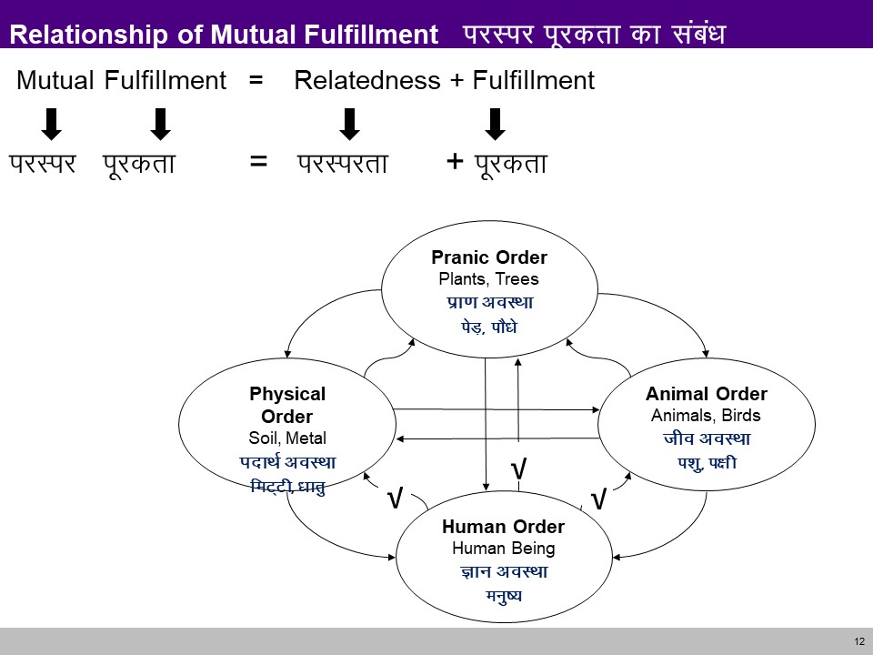
Interconnectedness and mutual fulfilment among the four orders of nature (CO5)

Slide 69
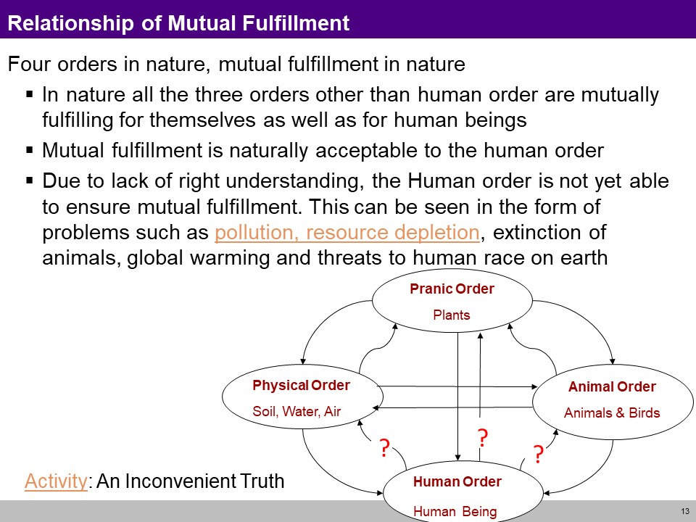
Interconnectedness and mutual fulfilment among the four orders of nature (CO5)

Slide 70
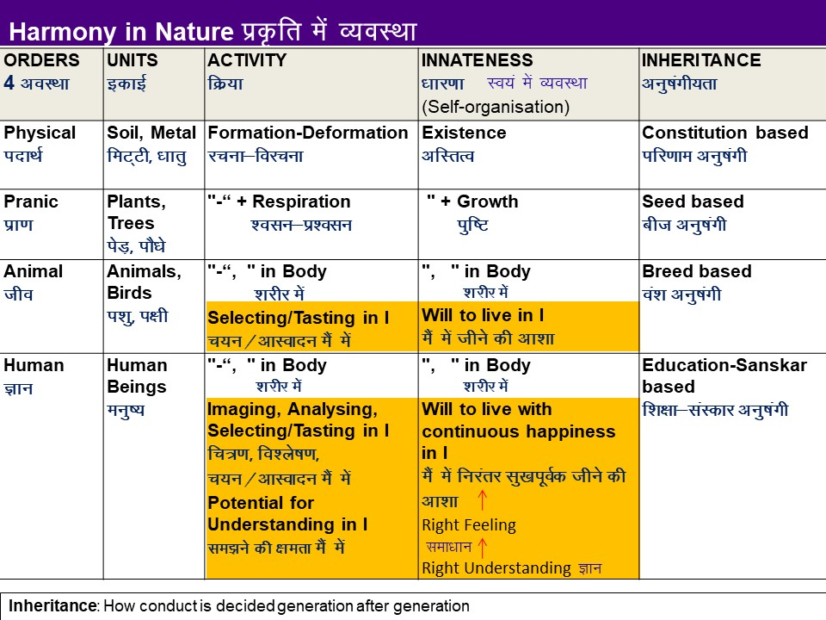
Interconnectedness and mutual fulfilment among the four orders of nature (CO5)

Slide 71
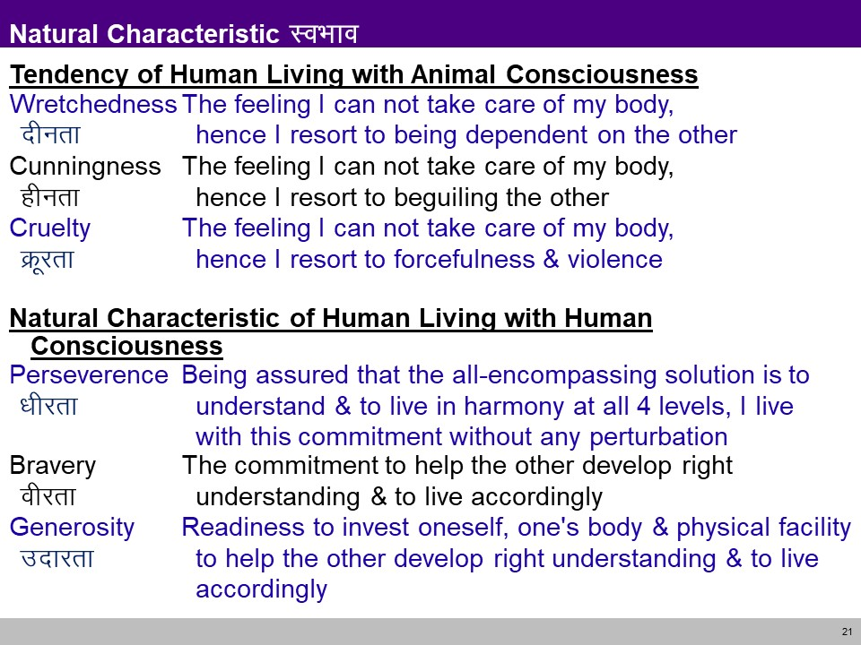
Interconnectedness and mutual fulfilment among the four orders of nature (CO5)

Slide 72
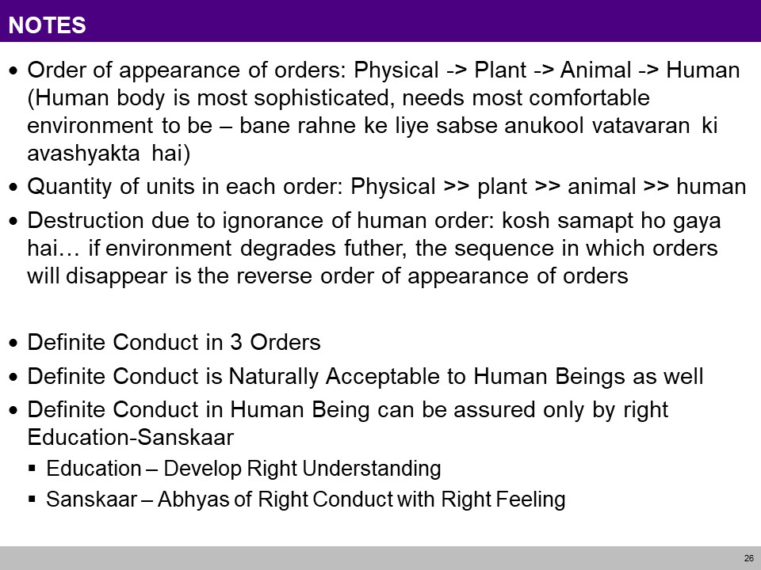
Interconnectedness and mutual fulfilment among the four orders of nature (CO5)

Slide 73
Thinking expansion for harmony

Slide 74
Johari Window model (CO5)
Objective:
To Understand Johari Window as a convenient method used to enhance communication between the members in a group

Slide 75
Johari Window model (CO5)
A Johari window is a psychological tool created by Joseph Luft and Harry Ingham in 1955.
Simple and useful tool for understanding and training:
self-awareness
personal development
improving communications
interpersonal relationships
group dynamics
team development; and
inter group relationships

Slide 76
Johari Window model (CO5)
4 Areas
Open area, open self, free area, free self, or ‘the arena‘: what is known by the person about him/herself and is also known by others
Blind area, blind self, or 'blindspot‘: what is unknown by the person about him/herself but which others know
Hidden area, hidden self, avoided area, avoided self or 'façade’: what the person knows about him/herself that others do not know
Unknown area or unknown self: what is unknown by the person about him/herself and is also unknown by others

Slide 77
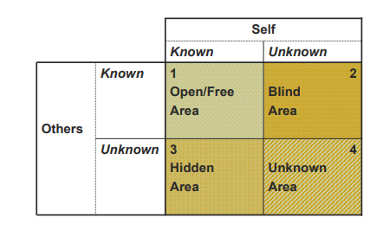
Johari Window model (CO5)
4 Areas

Slide 78
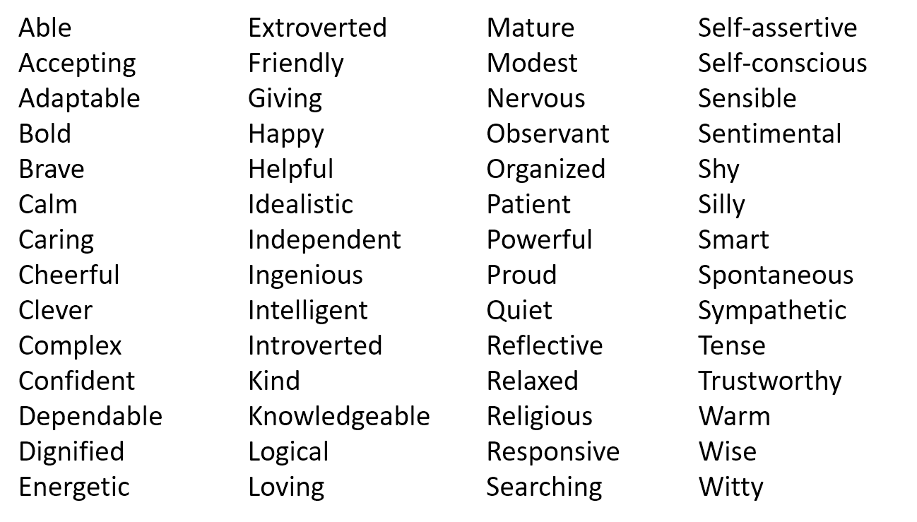
Johari Window model (CO5)
Exercise :
Step 1. Self Assessment:
Using the following list choose 5 adjectives that best describe yourself. Be objective and honest.

Slide 79
Johari Window model (CO5)
Exercise :
Step 2: Assessing Teammates
Once everyone has finished their own self-assessment, the entire team will evaluate their colleagues.
Assess your teammates with the same criteria you evaluated yourself. Remember to choose only 5 and to be both honest and objective.
Step 3 : Fill In the Johari Window Panes

Slide 80
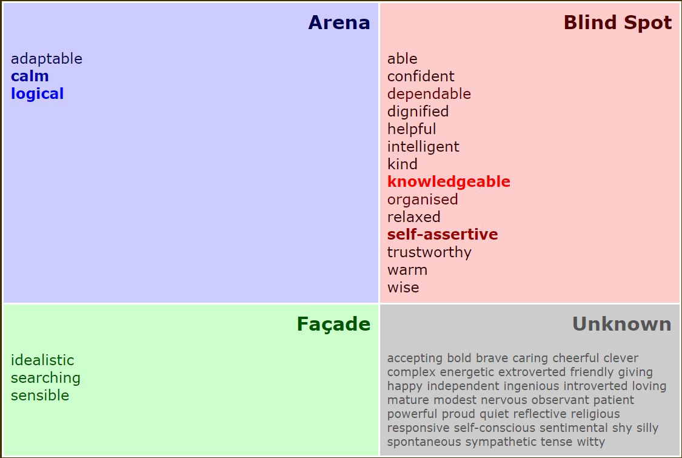
Johari Window model (CO5)
Open Area
Hidden Area

Slide 81
Group Behaviour (CO5)
Group behaviour refers to the situations where
people interact inside small groups, for example to reach or not a consensus and act in a coordinated way. This is the field of group dynamics.
large number of people in a given area behave simultaneously in similar way and have a similar goal, that might be different from what they would do individually (herd behaviour).

Slide 82
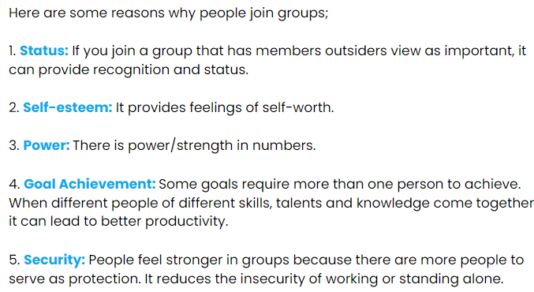
Group Behaviour (CO5)

Slide 83
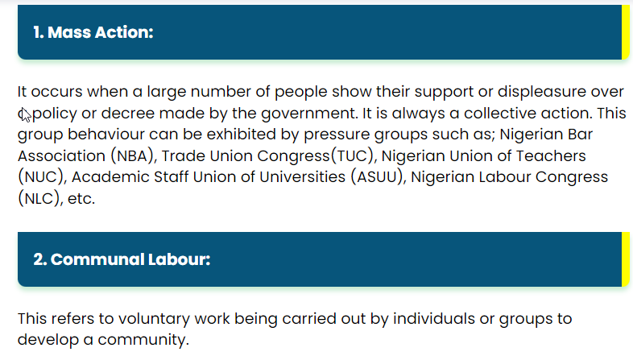
Group Behaviour: Types (CO5)
5 Types of Group Behaviour

Slide 84
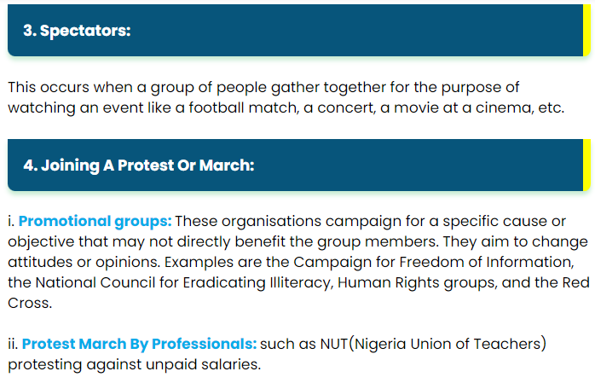
Group Behaviour: Types (CO5)
5 Types of Group Behaviour

Slide 85
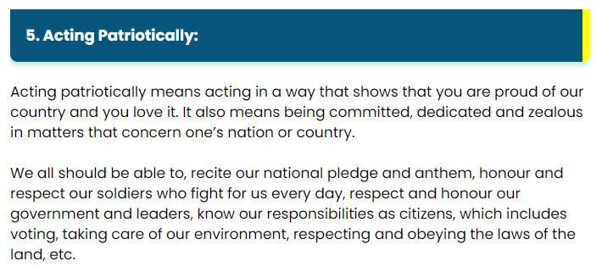
Group Behaviour: Types (CO5)
https://i.imgur.com/w8sHpP6.png

Slide 86
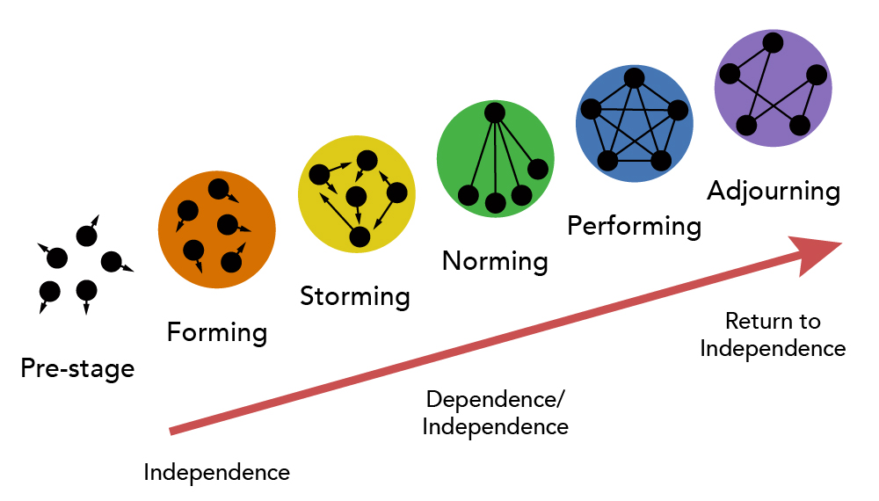
Group Behaviour: Tuckman’s Theory (CO5)
Tuckman’s theory was first proposed by psychologist Bruce Tuckman in 1965. It stated that teams would go through 5 stages of development:
forming,
storming,
norming,
performing and
adjourning.

Slide 87
Group Behaviour: Tuckman’s Theory (CO5)
Forming
The initial forming stage is the process of putting the structure of the team together.
Team members feel ambiguous and conflict is avoided at all costs due to the need to be accepted into the group.
Storming
This stage begins to occur as the process of organizing tasks and processes surface interpersonal conflicts.
Leadership, power, and structural issues dominate this stage.
Norming
In this stage, team members are creating new ways of doing and being together.
As the group develops cohesion, leadership changes from ‘one’ teammate in charge to shared leadership.
Team members learn they have to trust one another for shared leadership to be effective.

Slide 88
Group Behaviour: Tuckman’s Theory (CO5)
Performing
True interdependence is the norm of this stage of group development.
The team is flexible as individuals adapt to meet the needs of other team members.
This is a highly productive stage both personally and professionally.
Adjourning
In this stage typically team members are ready to leave (course termination) causing significant change to the team structure, membership, or purpose and the team during the last week of class.
They experience change and transition.
While the group continues to perform productively they also need time to manage their feelings of termination and transition.

Slide 89
Interpersonal behaviour and skills

Slide 90
Interpersonal behaviour and skills (CO5)
Objective:
To Understand Interpersonal skills related to the knowledge of social expectations and customs.

Slide 91
Interpersonal behaviour and skills (CO5)
Interpersonal skills are the behaviors and tactics a person uses to interact with others effectively.
In the business world, the term refers to an employee's ability to work well with others.
Interpersonal skills range from communication and listening to attitude and deportment.

Slide 92
Interpersonal behaviour and skills (CO5)
Eight interpersonal skills
1) Exercising Self-Awareness. ...
2) Being Cognizant of Nonverbal Communication.
3) Being Respectful of Others. ...
4) Showing Empathy and Understanding. ...
5) Being a Clear Communicator. ...
6) Engaging in Active Listening.
7) Behaving Appropriately
8) Being Receptive to Feedback
Notes:
https://bigthink.com/plus/top-8-interpersonal-skills-for-the-workplace/

Slide 93
Myers-Briggs Personality Type (CO5)
The Myers-Briggs Personality Type Indicator is a self-report inventory designed to identify a person's personality type, strengths, and preferences.
The questionnaire was developed by Isabel Myers and her mother Katherine Briggs based on their work with Carl Jung's theory of personality types.
Today, the MBTI inventory is one of the most widely used psychological instruments in the world.
Notes:
https://bigthink.com/plus/top-8-interpersonal-skills-for-the-workplace/

Slide 94
Myers-Briggs Personality Type (CO5)
4 Scales for determining MBTI personalities
Four different scales determine which one of 16 personalities you are:
Extraversion (E) and Introversion (I). We can think of extroverts and introverts as categories that are on the opposite side of the spectrum, like two extremes:
Extroverts are more action-oriented and feel energized after social interactions.
Introverts are more thought-oriented and they “charge batteries” when they’re alone.
Sensing (S) and Intuition (N). This scale refers to the way we gather information from the world around us:
Those who prefer sensing gather information from reality, facts and experience.
The ones who prefer intuition prefer impressions, possibilities, and abstract thinking.
Notes:
https://bigthink.com/plus/top-8-interpersonal-skills-for-the-workplace/

Slide 95
Myers-Briggs Personality Type (CO5)
4 Scales for determining MBTI personalities
Four different scales determine which one of 16 personalities you are:
Thinking (T) and Feeling (F). After we gather data, we process them in two ways:
Thinking, which involves logic-based processing.
Feeling, which involves emotion-based processing.
Judging (J) and Perceiving (P). This refers to our attitude toward the outside world:
Judgers prefer structure and order.
Perceivers prefer being flexible and spontaneous.
Notes:
https://bigthink.com/plus/top-8-interpersonal-skills-for-the-workplace/

Slide 96
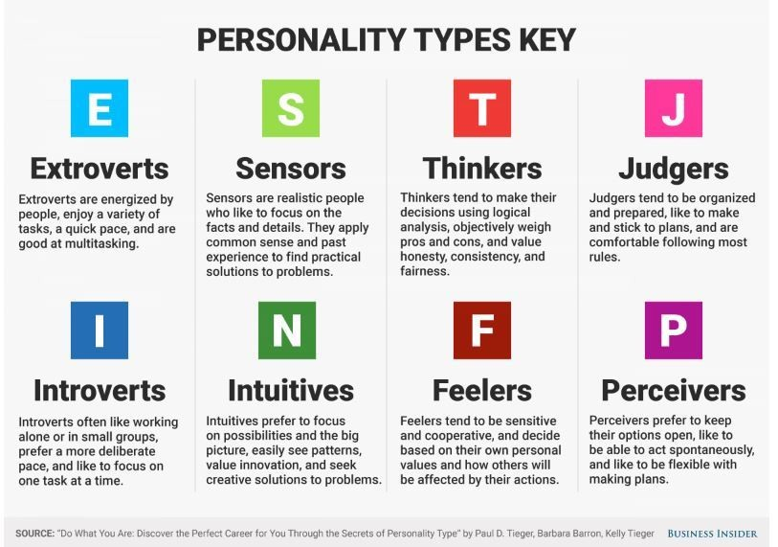
Myers-Briggs Personality Type (CO5)
Notes:
https://bigthink.com/plus/top-8-interpersonal-skills-for-the-workplace/

Slide 97
Myers-Briggs Personality Type (CO5)
The MBTI test includes four categories, and each category contains four personality types:
Analysts: INTJ (The Architect), INTP (The Logician), ENTJ (The Commander), and ENTP (The Debater).
Diplomats: INFJ (The Advocate), INFP (The Mediator), ENFJ (The Protagonist), and ENFP (The Campaigner).
Sentinels: ISTJ (The Logistician), ISFJ (The Defender), ESTJ (The Executive), and ESFJ (The Consul).
Explorers: ISTP (The Virtuoso), ISFP (The Adventurer), ESTP (The Entrepreneur), and ESFP (The Entertainer).
Notes:
https://bigthink.com/plus/top-8-interpersonal-skills-for-the-workplace/

Slide 98

Myers-Briggs Personality Type (CO5)
Notes:
https://bigthink.com/plus/top-8-interpersonal-skills-for-the-workplace/

Slide 99

Myers-Briggs Personality Type (CO5)
Notes:
https://bigthink.com/plus/top-8-interpersonal-skills-for-the-workplace/

Slide 100
FIRO-B Test(CO5)
The FIRO-B® (Fundamental Interpersonal Relations Orientation-Behavior™) instrument helps individuals understand their behavior and the behavior of others.
The first public iteration was derived in the late 1950s by William Shutz.
The basic premise for his theory was simple: “people need people”
With the insights of an individual’s interpersonal needs it can help improve workplace interactions.
Notes:
https://bigthink.com/plus/top-8-interpersonal-skills-for-the-workplace/

Slide 101
FIRO-B Test(CO5)
The FIRO-B test includes three main areas:
Inclusion
Control
Affection
Notes:
https://bigthink.com/plus/top-8-interpersonal-skills-for-the-workplace/

Slide 102
FIRO-B Test(CO5)
Inclusion is defined by the relationships one prefers to form with others. It explains the extent of which an individual enjoys or feels an aversion to being involved and invited by others. This word can also be associated with how much attention a person prefers to have from others.
Control is a word that can often carry a negative connotation, but in reference to the definition for this assessment, this word has to do with a preference for having an influence over others. It deals with a person’s preference for making decisions and amount of responsibility one may want to have.
Affection describe individuals interpersonal need for simple one-on-one relationships. It has to do with the want to know others on a personal level or how much an individual prefers to share their personal life with others.
Notes:
https://bigthink.com/plus/top-8-interpersonal-skills-for-the-workplace/

Slide 103

FIRO-B Test(CO5)
Each area is also modified by two further factors:
Expressed Behavior
Wanted Behavior
Expressed Behavior is how comfortable we feel about exhibiting a behavior toward other people.
Wanted behavior, is related to the level we want other people to exhibit a behavior toward us.
Notes:
https://bigthink.com/plus/top-8-interpersonal-skills-for-the-workplace/

Slide 104
FIRO-B Test Questionnaire (CO5)
Double click on PDF copy to open file
Notes:
https://bigthink.com/plus/top-8-interpersonal-skills-for-the-workplace/

Slide 105
Weekly Assignment
What is Johari Window of self-awareness?
What are the four windows of self in Johari Window?
What are the main goals of Johari's Window?
What is the most common Myer Briggs personality type?
What are the 16 personality types in order?
What does FIRO-B test measure?
Why FIRO-B is important?
How do you evaluate a FIRO-B score?
How many needs and dimensions does FIRO-B provide the scores on?

Slide 106
Faculty Video Links, Youtube & NPTEL Video Links and Online Courses Details
Youtube/other Video Links
Harmony in Society: https://aktu.ac.in/hvpe/HVPE%20Video%20Lectures/UHVPE%20Lecture%2020%20(Nature%20-%204%20Orders).wmv
Human Conduct: https://aktu.ac.in/hvpe/HVPE%20Video%20Lectures/UHVPE%20Lecture%2024%20(Human%20Conduct).wmv
Jain Darshan: https://www.youtube.com/watch?v=_7juhEpbu6Q&t=1398s
interpersonal behaviour and skills: https://www.youtube.com/watch?v=xd-2nKubrhA
Johari’s Window: https://www.youtube.com/watch?v=BWii4Tx3GJk&t=130s
Myers-Briggs personality types: https://www.youtube.com/watch?v=NXcWZnQPUXw
Firo-B Test
https://www.youtube.com/watch?v=ibZ1gKJu9EM

Slide 107
MCQ s
In the Johari Window, the information about yourself that you don't know but others do is your
blind self.
unknown self.
hidden self.
open self.
In the Johari Window, the things that we know about ourselves and keep to ourselves represent our
hidden self.
blind self.
open self.
unknown self.
When you move information from the hidden self into the open self, you're
empowering.
self-disclosing.
depressed.
affirming.
The more you perceive a situation as one in which others will evaluate you, the greater your _________ will be.
self-awareness
unpredictability
self-disclosure
apprehension

Slide 108
Glossary Questions
Select the correct answer
Glossary: i) blind self ii) unknown self iii) hidden self iv) open self
A) what is known by the person about him/herself and is also known by others
B) what is unknown by the person about him/herself but which others know
C) what the person knows about him/herself that others do not know
D) what is unknown by the person about him/herself and is also unknown by others
Select the correct answer
Glossary: i) Inclusion ii) Control iii) Affection iv) self disclosing
A) moving information from the hidden self into the open self
B) relationships one prefers to form with others
C) person’s preference for making decisions and amount of responsibility one may want to have
D) individuals interpersonal need for simple one-on-one relationships

Slide 109
Glossary Questions
Select the correct answer
Glossary: i) Chaksu ii) Achaksu iii) Avadhi iv) Kevala
A) perfect apprehension by the soul without the aid of senses and mind
B) apprehension directly by the soul without the aid of senses and mind
C) non visual apprehension with the aid of mind, ear, nose, tongue and skin.
D) visual apprehension with the aid of eyes.
Select the correct answer
Glossary: i) Extraversion ii) Introversion iii) Sensing iv) Intuition
A) Those who prefer sensing gather information from reality, facts and experience.
B) The ones who prefer intuition prefer impressions, possibilities, and abstract thinking.
C) Those who are more thought-oriented and they “charge batteries” when they’re alone.
D) Those who are are more action-oriented and feel energized after social interactions.

Slide 110
Expected Questions for University Exam
What is sanyam? How is it necessary in ensuring svasthya?
What is the responsibility of the self towards the body? How is it fulfilled?
What is meaning of justice in human relationships? How does it follow from family to world family?
What are the five dimensions of human endeavour in society conducive to ‘manaviya vyavastha’?
What is Samyak Darshan in Jainism?
Describe the concept of Triratna of Jain Philosophy.
What are the four windows of self in Johari Window?
What does FIRO-B test measure?

Slide 111
Summary
Achieve the comprehensive human goal: the five dimensions of human endeavour(Manaviya Vyavstha) are:
Education- Right living (Sikhsa- Sanskar),
Health – Self-regulation (SwasthyaSanyam),
Justice – Preservation (Nyaya- Suraksha),
Production – Work ( Utpadan – Karya),
Exchange – Storage (Vinimya – Kosh),
Darshan-Gyan-Charitra (Shifting the Thinking)
Interconnectedness and mutual fulfilment among the four orders of nature recyclability and self-regulation in nature
Thinking expansion for harmony:
Self-exploration (Johari’s window),
group behaviour,
interpersonal behaviour and skills,
Myers-Briggs personality types (MBTI),
FIRO-B test to repair relationships.

Slide 112
References
R R Gaur, R Sangal, G P Bagaria, A Foundation Course in Human Values and Professional Ethics, First Edition, 2009, Excel Books: New Delhi
Dr Ritu Soryan, Universal Human Values and Professional Ethics, 2022, Katson Books
Dr. Uday Kumthekar, Jain Darshan, 2012, Prasad Prakashan, Pune

Slide 113
References
Thank You

